Slide 1
Investigation of cooling falling droplets
Prepared by Aleksey Alekseev.

Slide 2
INTRODUCTION
In this work efforts were made to get equation that describes cooling of the falling droplet in a static air, namely T(H) formula, where H – height, which the droplet flies from. In the end, I will provide results of my own measurements and also comparisons with theoretical expectations.

Slide 3
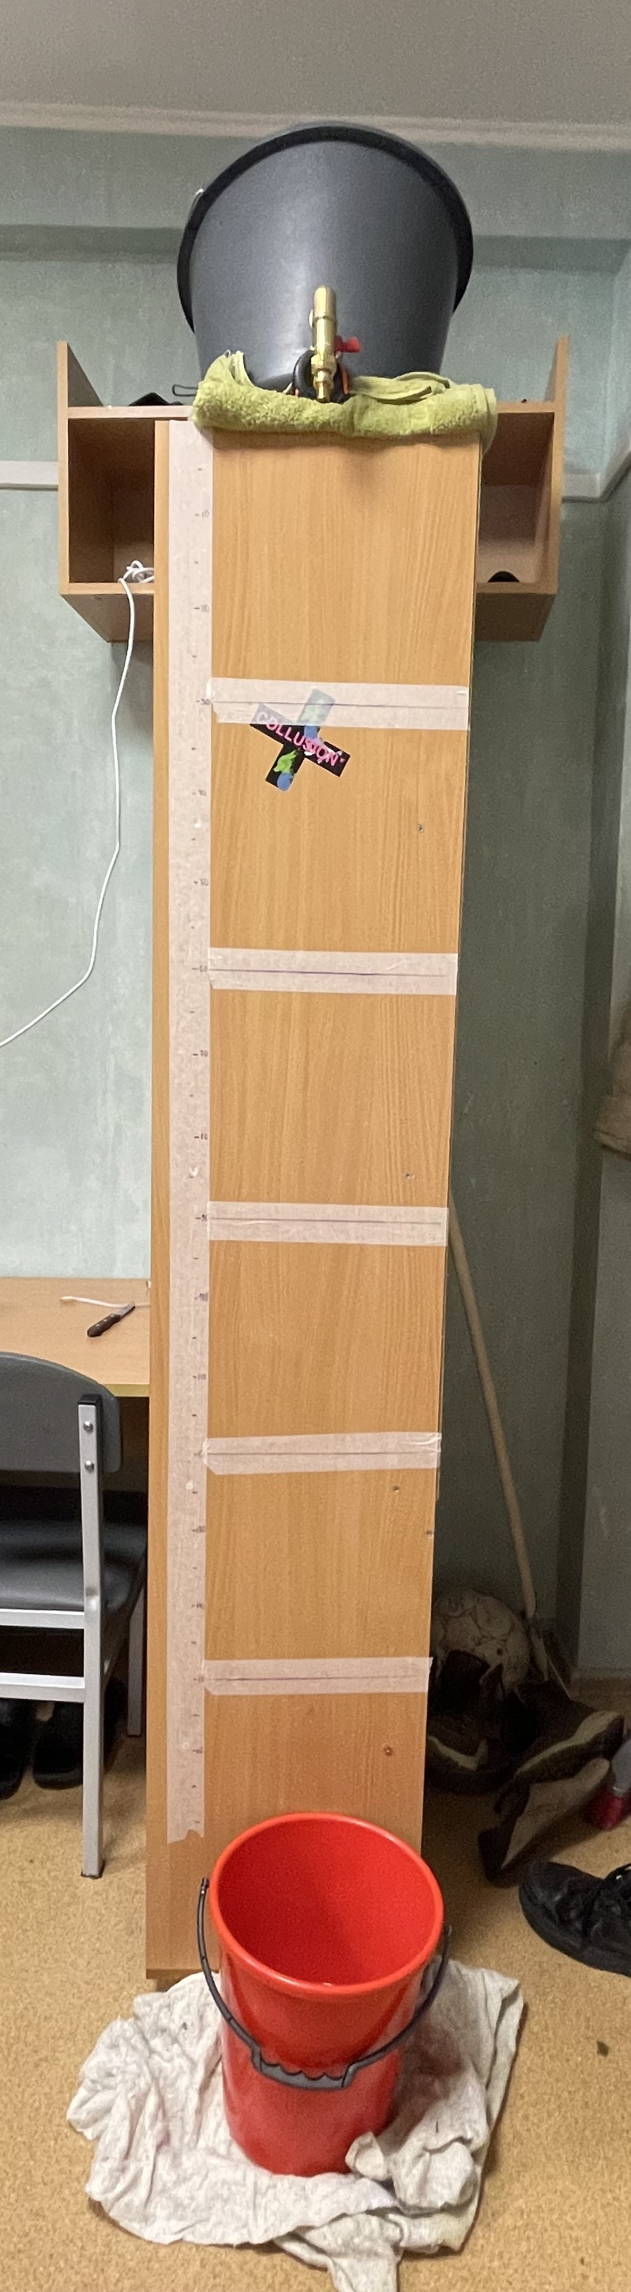
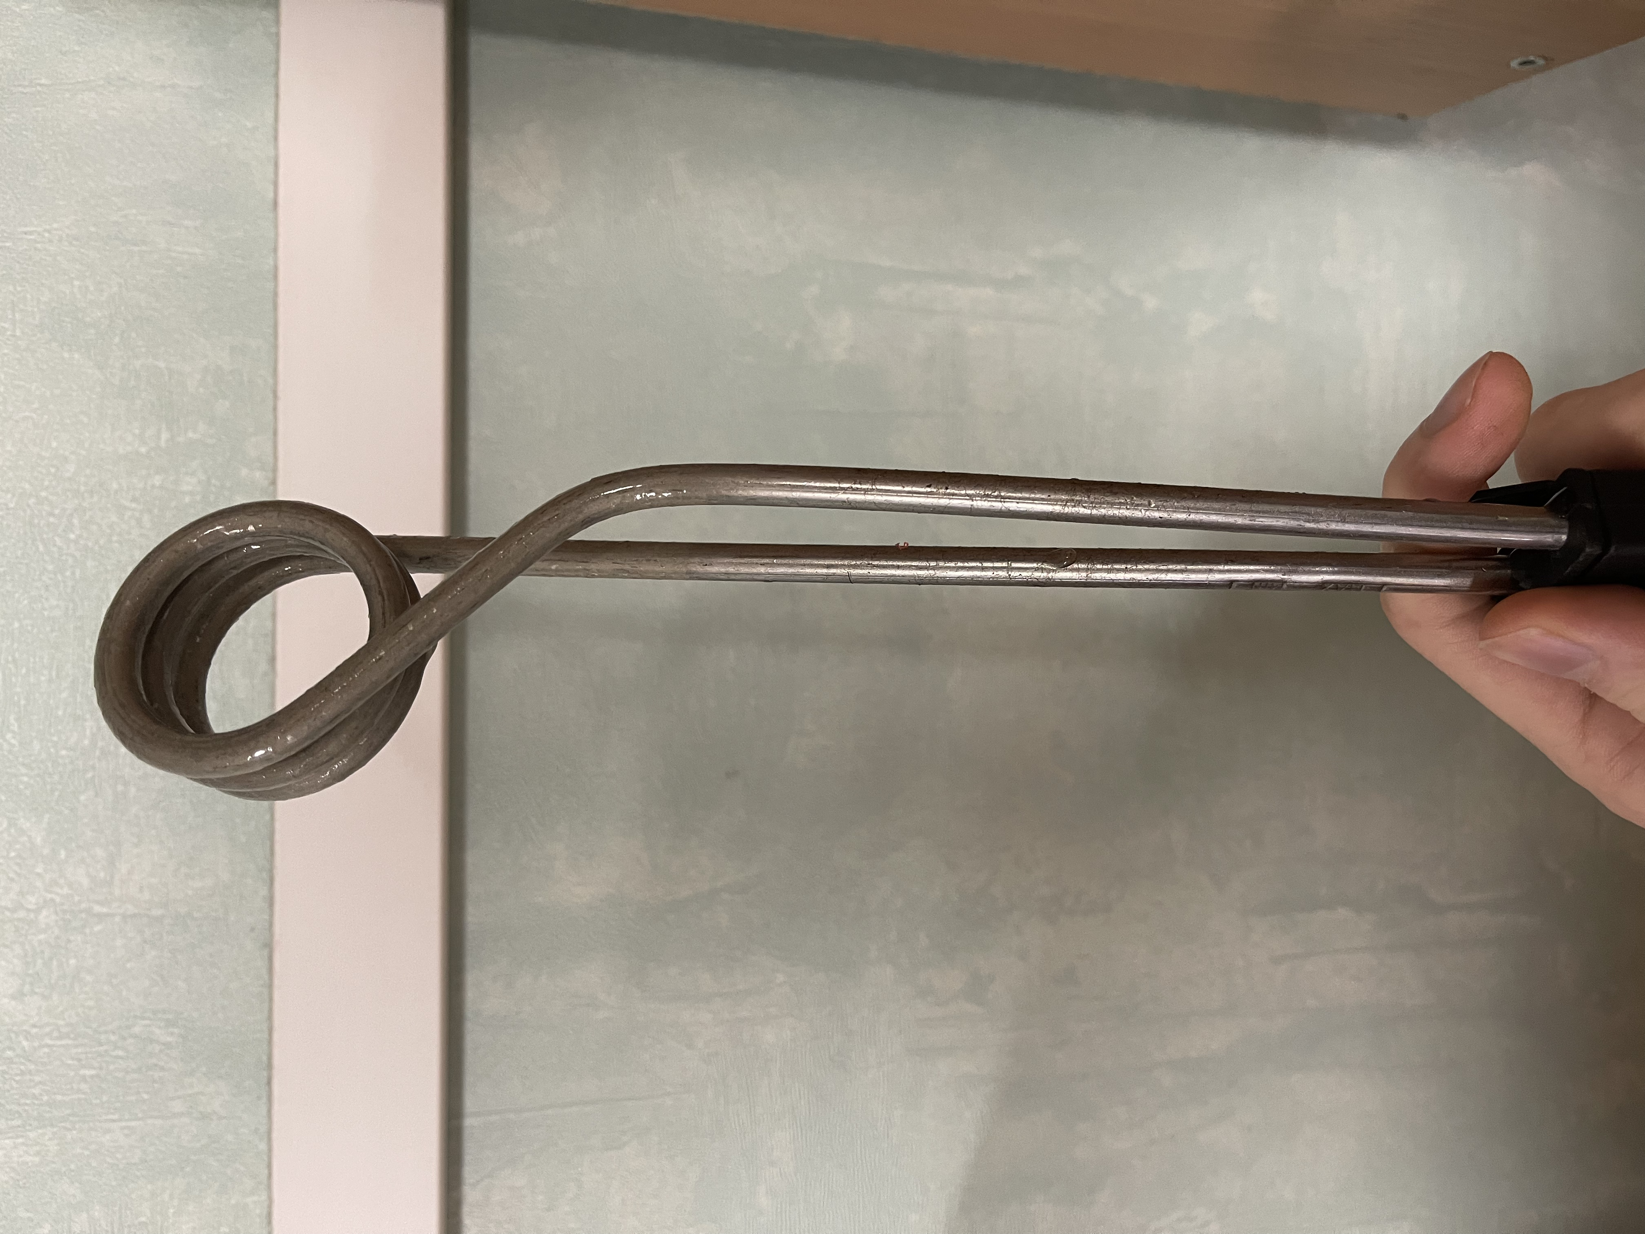
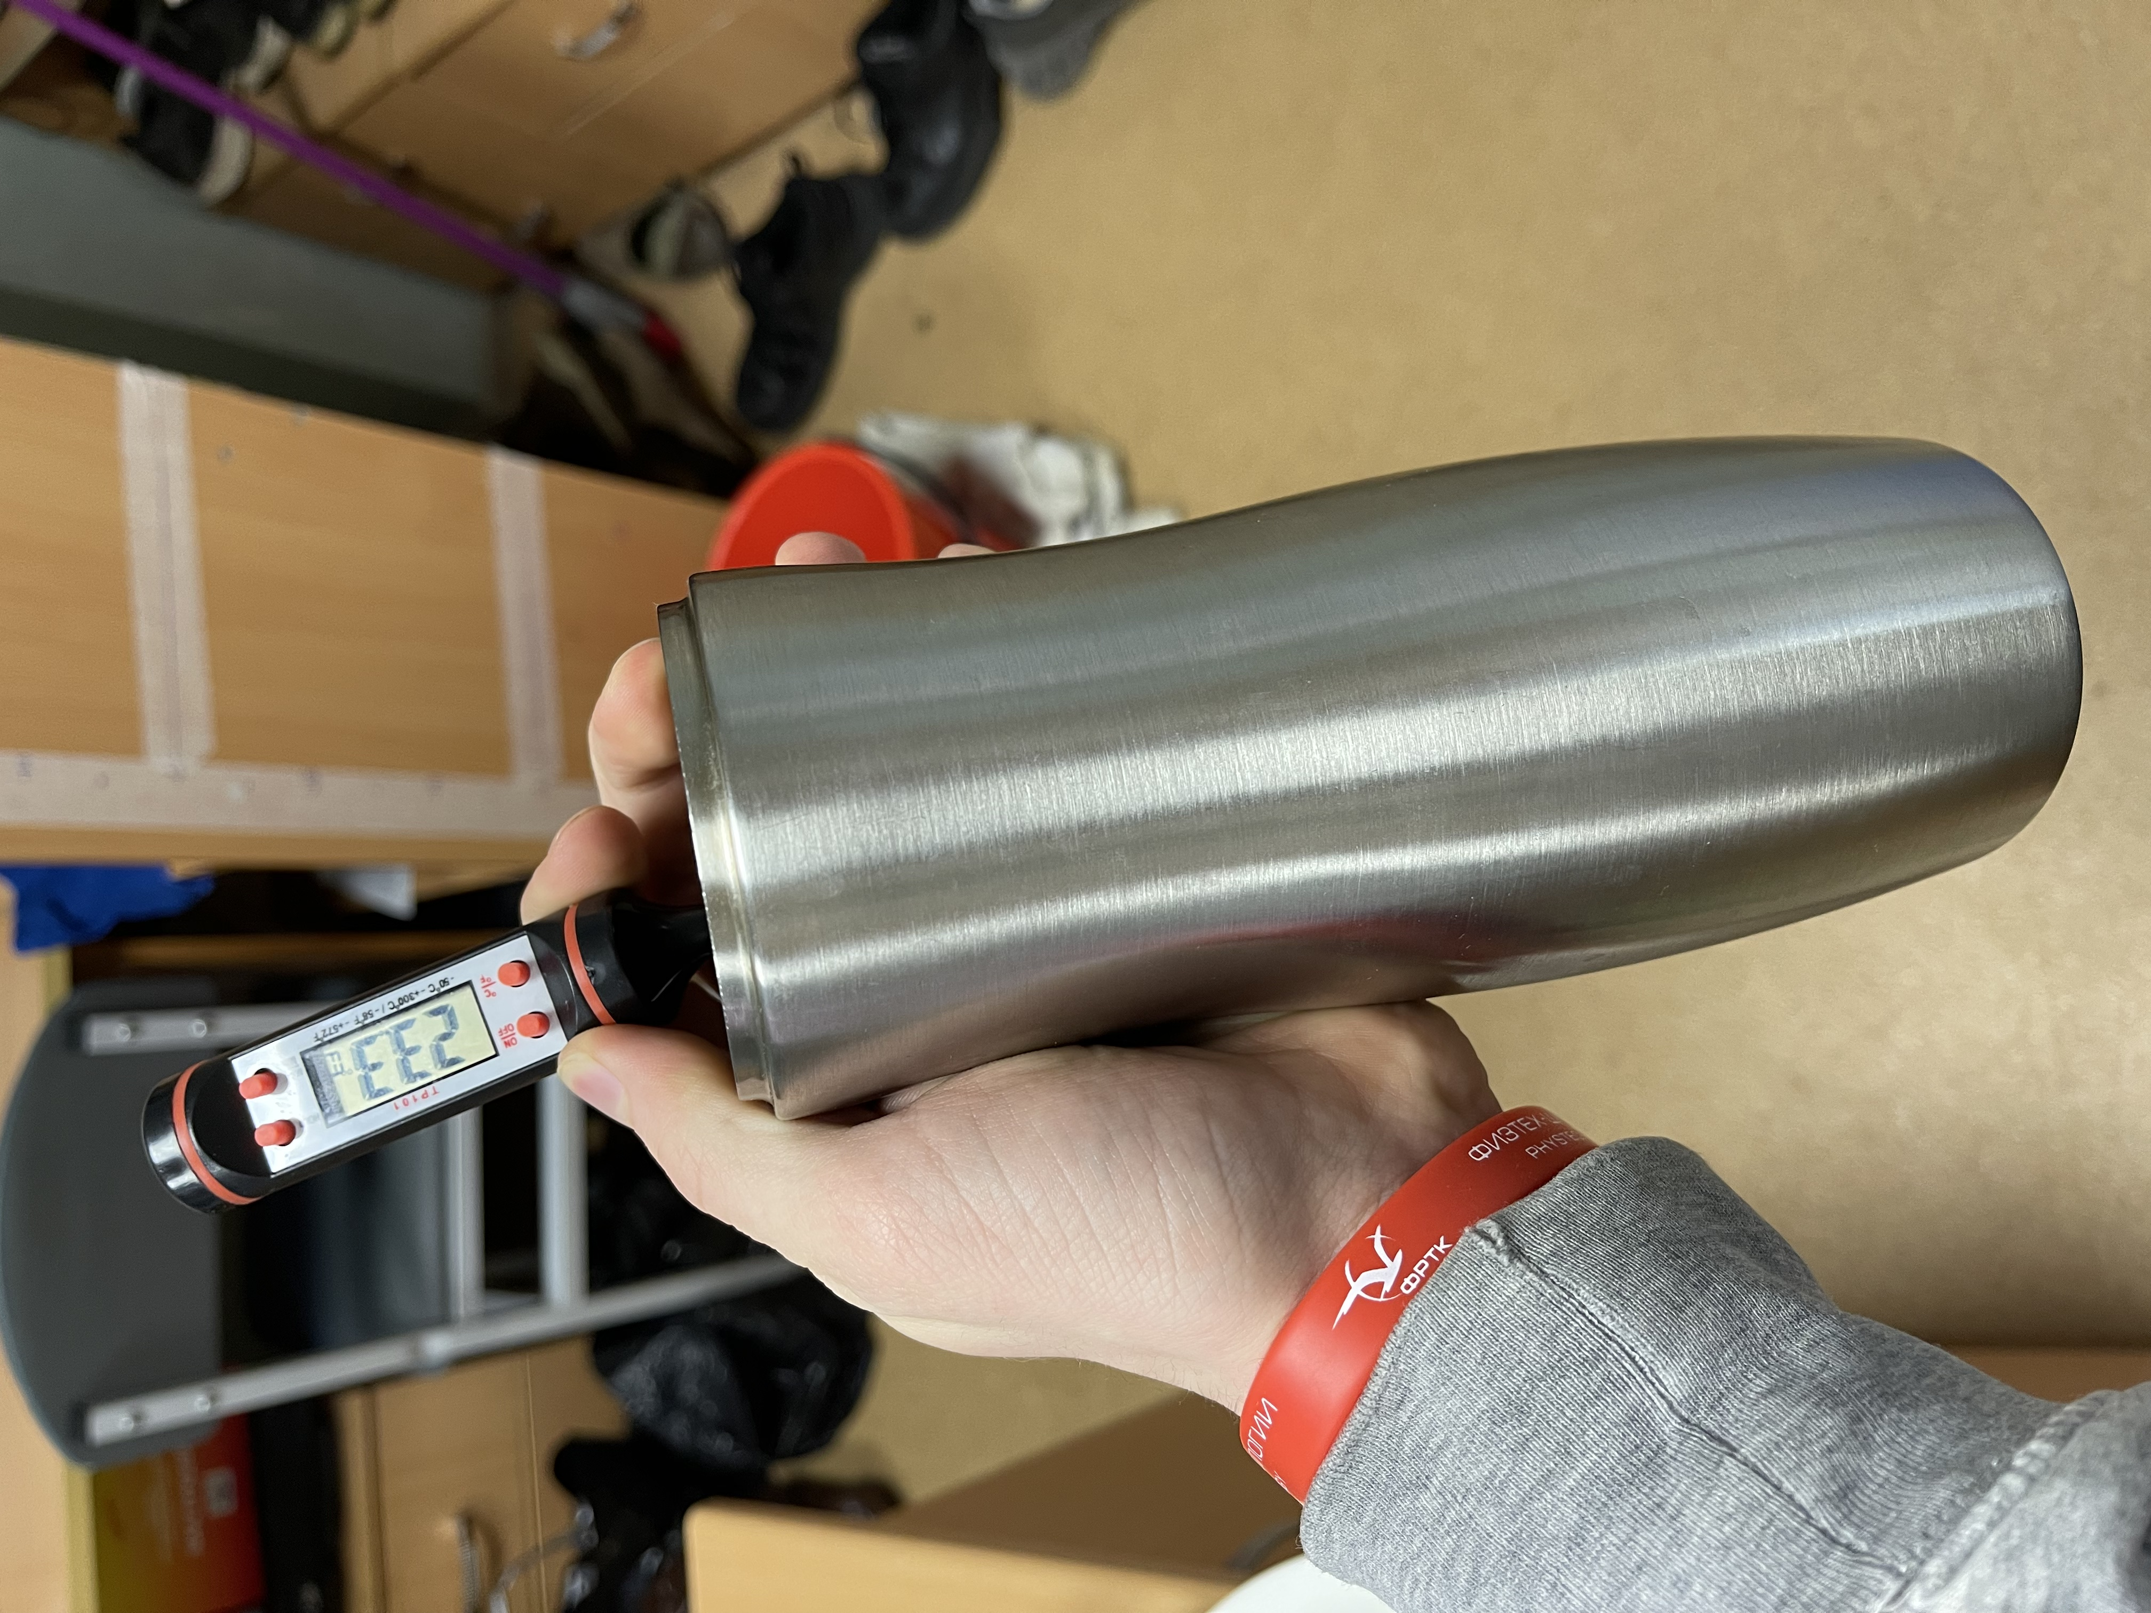
Experimental setup

Slide 4
Theoretical approach
Before writing down all of the equations, there is a list where are significant assumptions reflected:
1) The droplet is considered to be spherically symmetrical with a constant surface shape.
2) The water inside the droplet is static and temperature is the same throughout the volume of the droplet.
3) Main reasons of energy dissipation are evaporation and heat transferring.

Slide 5
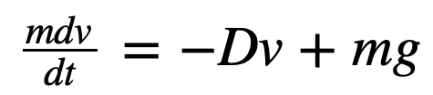
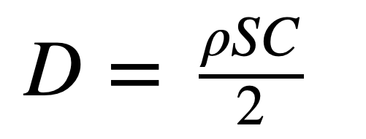
Droplet kinetics
Since the droplet moves in the air – drag force is applied on it. Second Newtown’s low will take the form:
, where D – dragging coefficient, that can be found from:
C – the figure that responsible for geometrical body’s properties and can be find as a table value. For example, for spherical bodies and 1 < Re < 2*10ˆ5,
C = 0,45.
(1)
(2)

Slide 6
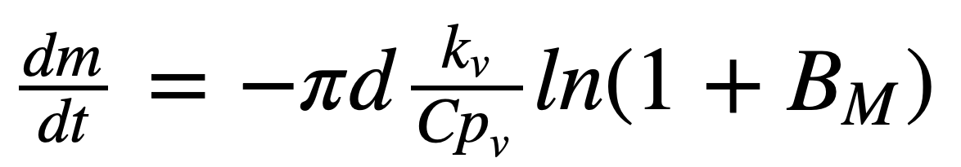
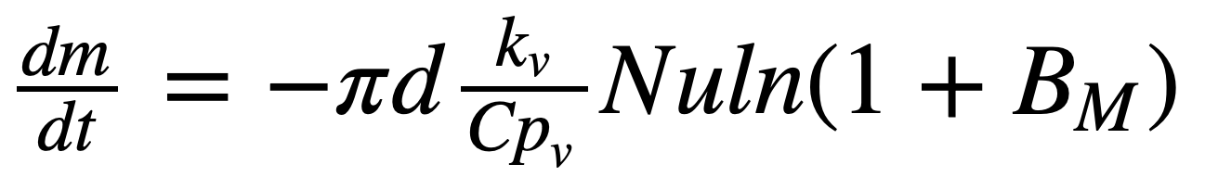
Droplet evaporation
Consider the spherical droplet with mass m, that evaporates, being surrounded only by the air. Thus, mass changes can be described with Stephan – Fuchs equation:
,where: d –droplet’s diameter,
k_{v} – thermal conductivity of droplet vapor. (W / m * K)
Сp_{v} – specific heat capacity of droplet vapor. (J / kg * K)
B_{M} – Spalding mass transfer number.
To apply this formula in my problem, its needed to be multiplied by Nu number, to define the role of convection during the process. So it leads us to:
(3)
(4)

Slide 7
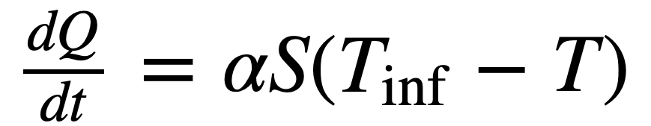
Heat transferring
Since the difference between droplet and surrounding air temperature is high, the heat flow can be obtained from Newton’s equation:
, where 𝛼 – convective heat transfer coefficient W / mˆ2 * K
In air, for forced convection, its value is in range 10 – 500 W/mˆ2*K
(5)

Slide 8
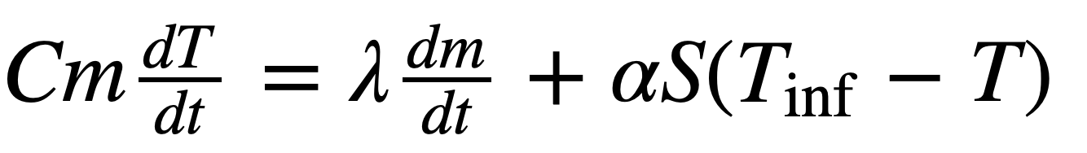
Energy exchange equation
Droplet-air energy exchange equation has an appearance:
The left-hand side term represents droplet’s cooling, when the right side provides reasons of it (evaporation and heat transferring).
(6)

Slide 9
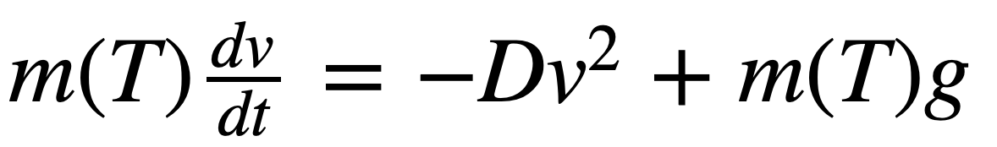
Uniting everything above
If we replace every unknown variable in the equation (6), using equations (1), (2), (4), (5) we will get a long differential equation with thermodynamics and geometrical properties as functions of the temperature and velocity. Complete solution only possible with help of special computers programs. For example, group of Mexican scientists had already simulated the cooling of falling droplet and got reliable results in certain extents, using pretty similar physical model.

Slide 10
Applying eased equation
Obviously, that on small heights (H < 5 m), role of the dragging force is negligible. So now 𝜈 = √2gh, where h – height of falling.
2) k_{v} , Сp_{v} can be taken from table as constants, also Nu, B_{M} are calculated as constants, therefore evaporation rate per unit of time is also constant.
3) Despite the mass decreasing, it has a relatively small effect on the droplet surface area changing. S and d – don’t change during experiment.

Slide 11
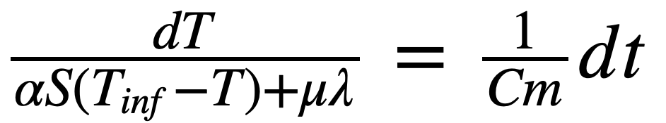
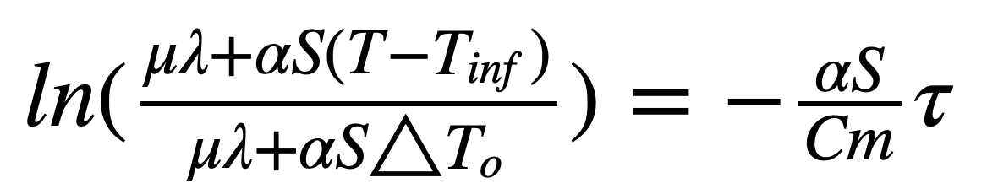
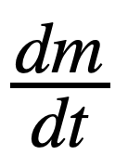
Applying eased equation
Eased differential equation (6) will be:
Easily integrating equation (6), finally get:
𝜇 =
∆T_{o} - initial temperature difference
𝜏 – time of the experiment
(7)

Slide 12
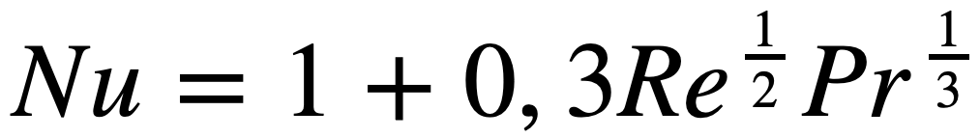
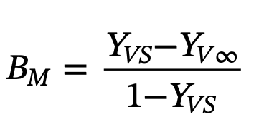
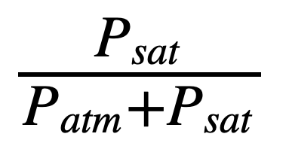
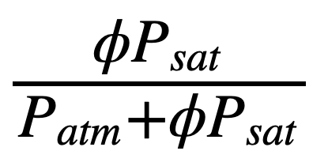
Applying eased equation
To find 𝜇, Nu can be determined from the following correlation:
And only B_{M} left: , ,
where Y_{vs} =
and Y_{v∞} = , where 𝜙 – air humidity.

Slide 13
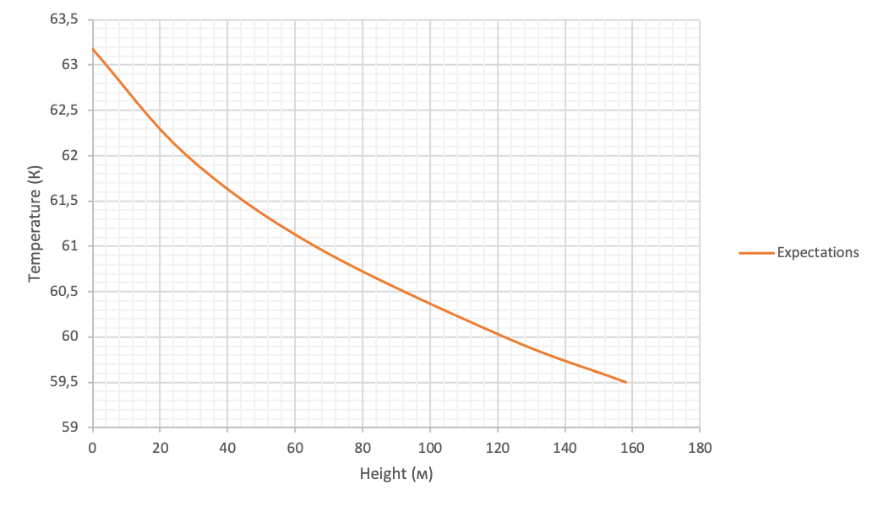
Expecting figures
Measurements were made for initial temperature T₀ = 336,18 K and heights up to 1,5m. Regarding to theoretical approach, graph is expected to be as followed:

Slide 14
Experimental results
𝜙 | T∞ | h0 = 0m | h1 = 0,3m | h2 = 0,6m | h3 = 0,9m | h4 = 1,2m | h5 = 1,5m
0,37 | 22,2 | 63,2 | 61,9 | 61,5 | 60,6 | 58,5 | 58,1
0,38 | 22,3 | 64 | 62,3 | 61,6 | 61,2 | 60,5 | 59,4
0,4 | 22,3 | 62,1 | 62,1 | 61,7 | 59,8 | 59,7 | 60
0,37 | 21,8 | 63,1 | 62,9 | 61,2 | 59,4 | 58,9 | 59,6
0,39 | 22 | 63,5 | 62,6 | 61 | 61,2 | 60,1 | 59
0,38 | 22,12 | 63,18 | 62,36 | 61,4 | 60,44 | 59,54 | 59,22

Slide 15
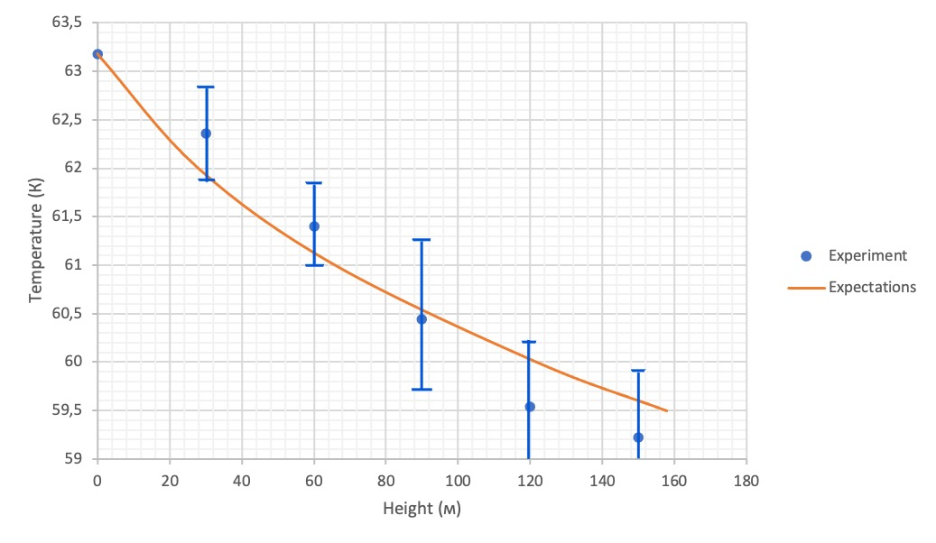
Experimental results

Slide 16
Experiment results review
All neglects were maid correct and experimental results matched with theoretical expectations within the margin of error.
In average, relative error due to temperature value measurments made up around 1%.
However, in comparison to observable temperature range, errors are noticeably huge in their absolute values.
Obtained formula, that can be used in such eased conditions.

Slide 17
Opportunities for work improvement
1) Investigate T(H) dependency, when parameters such as humidity, surrounding air temperature, initial height, initial droplet temperature can be changed.
2) Improve experimental set up to increase possible temperature range.
3) Come up with new way of temperature measuring to increase accuracy.
4) Heat transferring coefficient should be obtained from direct experimental results.

Slide 18
Conclusion
1) Very though mathematical model was found, that solves this problem for variety of heights and temperatures.
2)A lot of neglects and everything matched!
3) Unfortunately, obtained formula wasn’t fully checked in different conditions.
4) This problem is full of the interesting parameters, that are very complicated to be numerously estimated.

